Slide 1
Recept application
By Újvárosi Gábriel and Fekete Zoltán

Slide 2


Project Members
Újvárosi Gábriel
Majority of the code
PPt
Fekete Zoltán
Acquisition of the recipes.
Small part of the code
Design and Wireframe

Slide 3
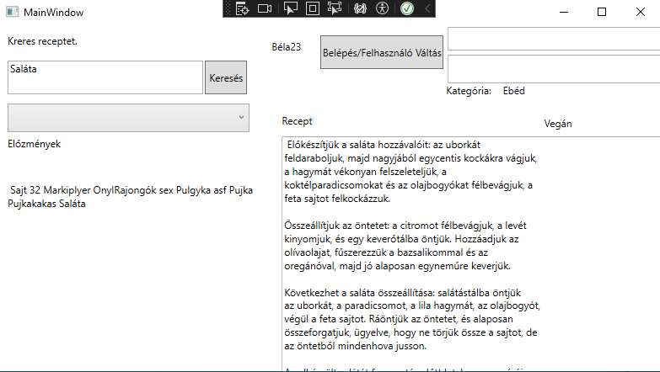
The Product itself.

Slide 4




Used Tools
Github – For sharing and storing files
Messenger – For communication
Microsoft Visual Studio – For editing the code.
Figma – For designing the user interface

Slide 5
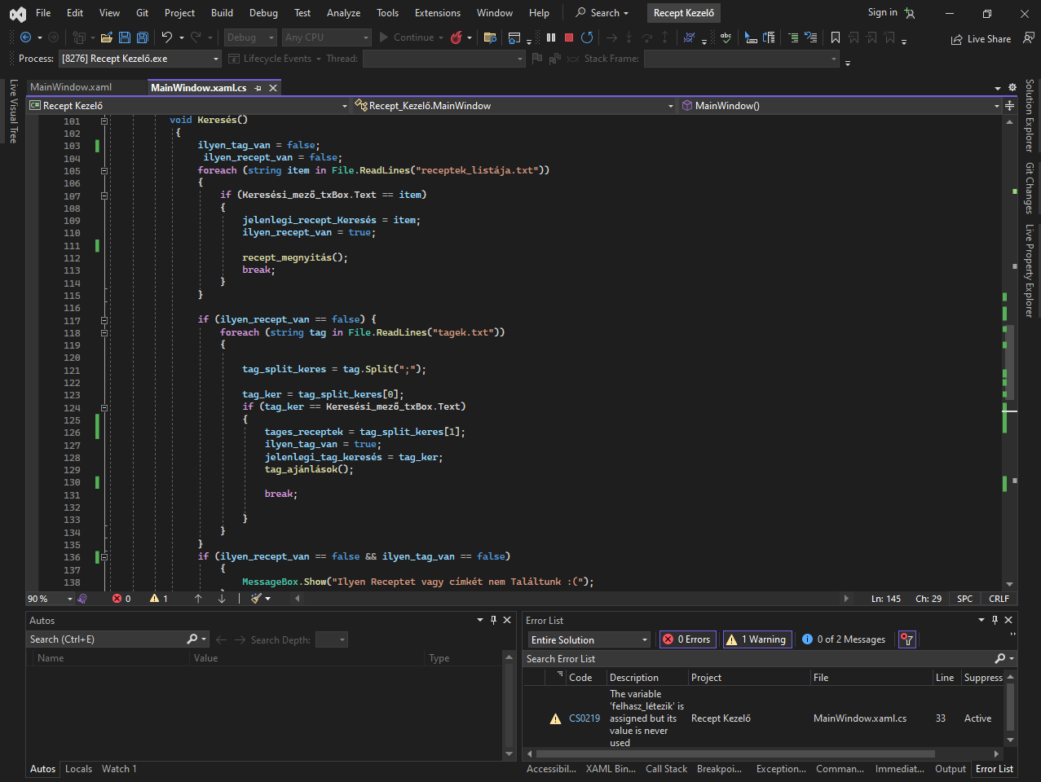

Slide 6
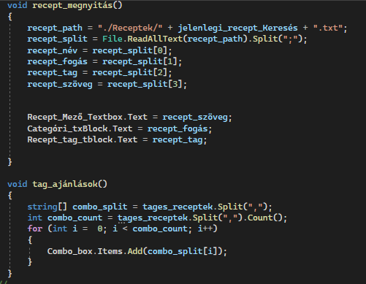

Slide 7
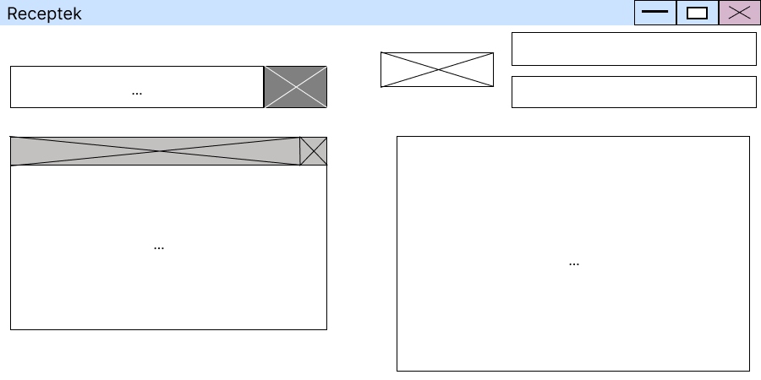
Wireframe

Slide 8
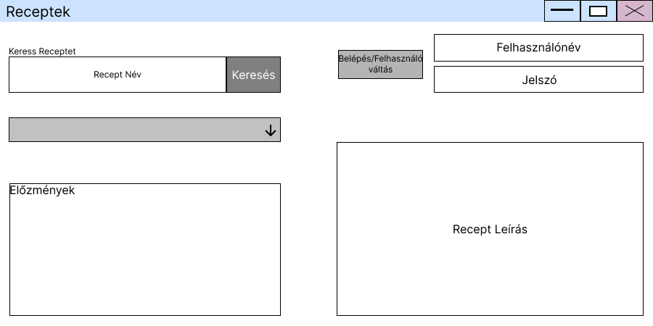
Design

Slide 9
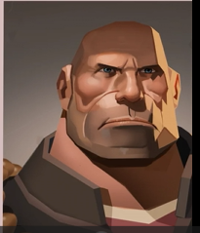
Thank you for your attention!

